Slide 1
Top Bins Soccer Shop
By Sam Barrionuevo
UX Design

Slide 2
Table of Contents
Website Wireframes 34-47
Webpage Scope and Detail 35 – 41
Hierarchy of visual precedence 42
Color palette 43
Responsiveness of Design 44-45
Implementation of icons 46-47
User Testing and Website Revisions 48-63
Survey Questions 49-51
User Testing and Results 52
Qualitative and Quantitative Results 53-58
Final Synthesis 59
Wireframe Changes 60-63
Visual Design Components 64-68
Implementation of Visual Design 65
Implementation of Icons 66
Design Mockups 67--68
Summary and Synthesis 69
Business Strategy 3-12
Project Concept Summary 4
Competitive research 5-8
Pain Point Mind Map 9
Problem Classification Table 10
Business and Customer Analysis 11-12
Personas 13 - 21
User Narratives 14, 16, 18, 20
User Stories table 15, 17, 19, 21
Website Taxonomy 24-33
Main sections 25
User Flows 26-29
Site Map and Splits 29 - 33

Slide 3
Business Strategy
Chapter 1

Slide 4
Project Concept Summary
Top Bins Soccer Shop is a resource for the people of Franklin, Tennessee to get all of their officially licensed merchandise and soccer equipment at prices that beat other competitors. Not only do we have better prices, but we strive to have the most expansive collection of gear, jerseys, and paraphernalia.
For customers, it can be hard to settle because the gear does not completely satisfy their desires. From high-tier to low-tier cleats, the newest team kits, and the most popular equipment, we have it all. Not only that, but we prioritize helping our customers find what they want.
Many times people come to soccer shops in search of the perfect gear without a brand or model in mind. We are here to help you find exactly what you are looking for and want to have the resources for our consumers to make the best purchase.
The website will be e-commerce centered. The main page will introduce our company with a marketplace available so the customers can find their desired gear with highly detailed displays of gear and equipment, detailed statistics on the attributes of each product, and a selection that guarantees satisfaction.

Slide 5
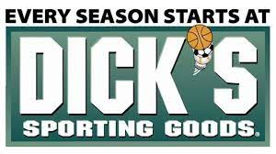
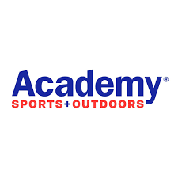
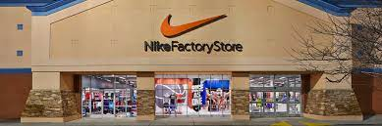
Competitive Research
Though there are not many soccer specific shops in Franklin, Tennessee, there are many sporting goods stores that sell soccer merchandise and equipment. Though it can be easy to be distinct in that we would be the only soccer specific shop in the direct area, many people would prefer a well-known seller such as Academy Sports, Dicks Sporting Goods and local Nike Outlet Factory Stores.
A soccer centered website makes Top Bins unique compared to competitors because the marketplace is solely soccer centered. All gear and equipment can be organized in categories that make the website unique compared to the ambiguous selections that these big retailers offer.

Slide 6
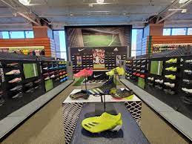
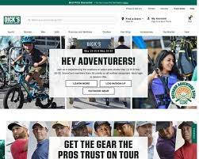
Dicks Sporting Goods https://www.dickssportinggoods.com/
Dicks Sporting Goods is not particularly known for excelling in one singular sport, but for many they are known for reliably having top brands available for customers. In the past few years, their selection has been improving when it comes to soccer equipment and merchandise. Though for more experienced soccer players and coaches, Dick’s might not be their first choice, they are known to sell the most to a less experienced demographics.
Their web presence is similar to they’re physical store in that it isn’t catered specifically to soccer, but rather they sell items by band and demographic. It can be noted that their website makes it complicated to navigate to their soccer selections. In, addition when looking at a specific cleat and some merchandise, it can be hard to look into what materials the product is made of.
In addition for some equipment the usage can be ambiguous. An example being their cleat selection does not give material, or whether it is made for soft ground or hard ground.

Slide 7
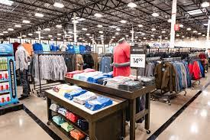
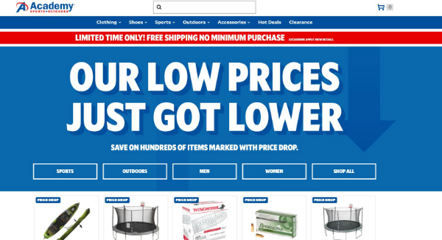
Academy Sports https://www.academy.com/
Academy sports is another sporting goods store not focused on a specific sport. They are mainly known for their athletic clothing, rather then their sports equipment or merchandise. Like Dicks, they also have a growing sports influence in their store, this applying to soccer as well.
After researching they’re website, I found it increasingly hard to even find sports related items as well as soccer items. Though they are available, they seem to have put more emphasis on their sales and in-season items rather then any sport or hobby. For less experienced web users, this can be an issue when trying to find soccer related items because it requires so much effort.
After searching their soccer related items, I found that though their items seem to be listed in a detailed fashion, their selection when it comes to soccer equipment, cleats especially, and also soccer team merchandise does not have very expansive selections.
If a customer has a specific item in mind, it can be increasingly complicated to find what they want from Academy Sports

Slide 8
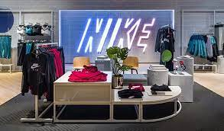
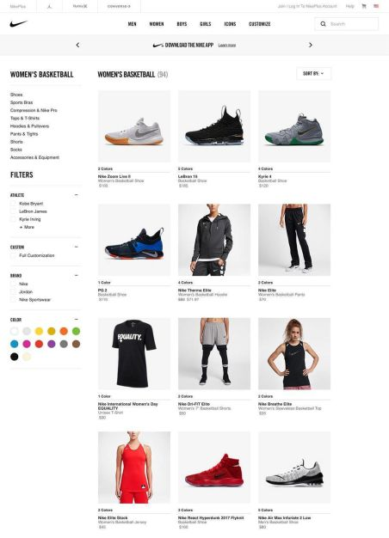
Nike Outlet Factory Store https://www.nike.com/w/sale-3yaep
The Nike factory outlet store is known for having reliable selections of soccer gear because of Nike’s prominence the soccer world. I found they’re website to be the best because it was the easiest to find their soccer selections and their models were intuitive and well designed.
The quality of their products and website makes their reliability well known. Their main downfall is that their soccer selections are only limited to Official Nike gear and equipment.
Because some consumers prefer other brands or models not found on the site, it can be a reason to drive customers away.

Slide 9
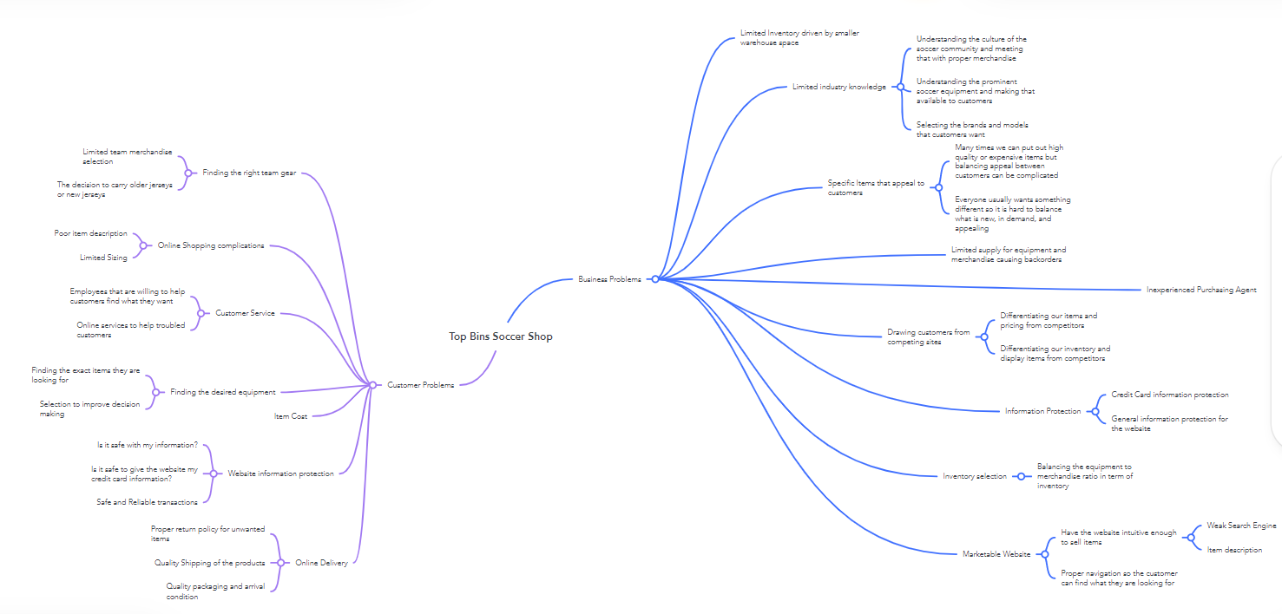
Pain Point Mind Map

Slide 10
Diagnosis and Problem Classification Table
Business Pain Points | Customer Pain Points
Inventory Selection and Customer demand | Customer Service
Customer Loyalty | Constant Need for Equipment and Merchandise
Information Protection and Transactions | Website Navigation
E-commerce Website item Marketability | Online Delivery Process

Slide 11
Business and Customer Analysis
Business Analysis
Customer Analysis
The purpose of this project is to bring the high quality marketplace that we provide to the internet. This increases sales because our website makes the high quality marketplace we have online. It allows users to make purchases and decisions without having to make the in person trip.
We want their decisions to be well informed and give them a selection of the best products. We hope to increase the popularity of our shop to customers in the area.
The needs of our customers remain consistent as the need for soccer gear will always need to be filled. But this website takes our company a step up because it gives our customers the efficiency of ordering equipment and merchandise without having to leave the comfort of their homes.
This increases our target market and satisfaction rate as our marketplace is available to all consumers. The merchandise demand is increasing too with the World cup coming up.

Slide 12
Customer Journey Map
Research:
Customers start to look for sports outlets and soccer shops in their area
Awareness:
Customers need somewhere to purchase soccer equipment and merchandise
Consideration:
The customer finds our location or website and searches our selections and models
Support:
As customers continue to have soccer-related needs, both old and new customers rely on Top Bins and spread the word about the new soccer shop in town
Purchase:
The customer finds that they are looking for, they make an initial purchase and the word spreads to the community.

Slide 13
User Personas
Chapter 2

Slide 14

Timothy Watson
Scenario
Needs
After researching into some soccer cleats and brands that would suit him, he decides to search local sports stores and soccer shops with desired cleat selection. He hopes to find some cleats and shin guards that fit him.
Accessible shop to buy equipment
Reasonably priced gear
Helpful customer service
Extensive collection of soccer gear
Helpful recommendation system
Narrative
Timothy Watson is a 34 year old electrician that lives in the Franklin area. He is a single father and is passionate about making sports a part of his son’s life. He likes watching sports on TV but wants to take his son to watch him play in person. He recently joined a co-ed soccer team and wants to get some soccer gear that will last him for the season.
Result
Timothy finds the Top Bins Soccer Shop Website and decides to browse their cleat selection. He finds their cleat section easily and navigates through until he finds the cleats he wants. He can look at the specifications of each product and likes how he can see exactly what he’s buying. After he finds some cleats he likes, he finds shin-guards, the next thing he needed in his suggestions. He adds them to his cart and finds that he can order all of his equipment online after making an account. He proceeds to make an account and buy his gear.

Slide 15
User Stories Table
User | User Story
Persona 1: Timothy Watson | As a user I need an accessible soccer shop to buy soccer equipment
Persona 1: Timothy Watson | As a user I need a place to find reasonably priced soccer gear online
Persona 1: Timothy Watson | As a user I need a place with an extensive amount of soccer gear
Persona 1: Timothy Watson | I need helpful customer service and recommendations

Slide 16

Henry Heinrich
Scenario
Needs
Harry wants to get some World Cup gear to help support his home country. While looking online, he finds that many stores are selling World cup gear but is frustrated that many stores do not have Germany gear. After searching for Germany world cup gear online, he finds a local shop called Top Bins.
Extensive online inventory
Modernized paraphernalia selection
Advanced UI for international customers
Jersey selection page
Efficient search bar
Narrative
Results
Henry is an engineer at Volkswagen factory in Nashville, TN. He loves his home country Germany and likes to follow the soccer in his home country. He also plays on his local Sunday league team. He is looking to watch the world cup and hopefully watch Germany win.
Henry finds the Top Bins soccer shop website after searching for local jersey retailers. He is excited to find a World Cup sale going on with many international jerseys. He easily finds the latest Germany jersey and finds that his size and model are in his stock. He creates an account for a discount and puts the jersey in his cart. He notes that Top Bins was one of the only stores to have international jerseys in stock. He then pays online and receives his order a few days later.

Slide 17
User Stories Table
User | User Story
Persona 1: Henry Heinrich | As a user I need soccer shop with an extensive online inventory
Persona 1: Henry Heinrich | As a user I need a modern team paraphernalia selection
Persona 1: Henry Heinrich | As a user I need an advanced UI for international customers
Persona 1:Henry Heinrich | As a user I need an efficient search bar system

Slide 18
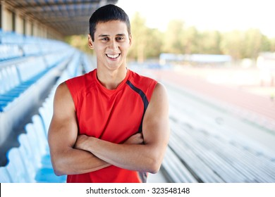
Andre Jimenez
Scenario
Needs
After talking to one of his friends he hears about a local soccer shop, Top Bins. Because he does not have car, he decides to go to their website and look at their cleat selection. He hopes top find the exact cleats he is looking for.
Website with updated inventory
Established online presence
Intuitive website design
Easy to find cleat selection
Cleat specifications list
Online model of cleat specifications
Narrative
Andre Jimenez is a 17 year old high school student at Summit High School. He played sports growing up and currently plays for their men’s soccer program. After a hard practice he recently broke his latest pair of cleats. He needs cleats soon for his upcoming game and wants one of the latest models to wear.
Result
Andre finds their website and looks at their cleat selection. He is impressed that their selection includes many of the recently released cleats worn by his favorite players and friends. He browses the interface and finds that he can easily find the price and attributes of each cleat. He finds the exact cleat he was searching for and finds the amount of models and model tiers impressive. He puts the desired cleat in his cart and orders it. It arrives in a few days and he wears his cleats to his game.

Slide 19
User Stories Table
User | User Story
Persona 1:Andre Jimenez | As a user I need a website with an updated soccer inventory
Persona 1: Andre Jimenez | As a user I need a soccer shop with an established online presence
Persona 1: Andre Jimenez | As a user I need an easy to find cleat selection
Persona 1: Andre Jimenez | As a user I need to see the cleat specification in an online model when attempting to buy

Slide 20

Worton Whelan
Needs
Scenario
Modern cleat selection
Popular brand models
High quality gear in stock
Quick and easy online service
Efficient item delivery system
Worton has spent a lot of his time training and needs a new ball and cleats. He decides to browse online to try to get new gear before his trial with Nashville Soccer Club.
Narrative
Worton is a 24 year old semi-pro soccer player in the Nashville Area. He has a business degree from Belmont University and just graduated college. He also played for their Men’s Soccer program. Before he attempts to get a job using his degree, he wants to attempt to take his soccer career to the pro level.
Result
Despite the fact that Worton usually gets his high quality cleat balls shipped from out of state like many pro soccer players, he finds the Top Bins website. He finds that they have a lot of the newest cleat models and even sell soccer balls that interest him. He decides to order a new pair of cleats and a set of balls because he is so impressed with the selection. He gets his equipment in a few days and is very happy to with the quality gear and efficient delivery.

Slide 21
User Stories Table
User | User Story
Persona 1: Worton Whelan | As a user I need a modern cleat selection
Persona 1: Worton Whelan | As a user I need popular brands and models available
Persona 1: Worton Whelan | As a user I need a quick and easy online service
Persona 1: Worton Whelan | As a user I need an efficient item delivery system

Slide 22
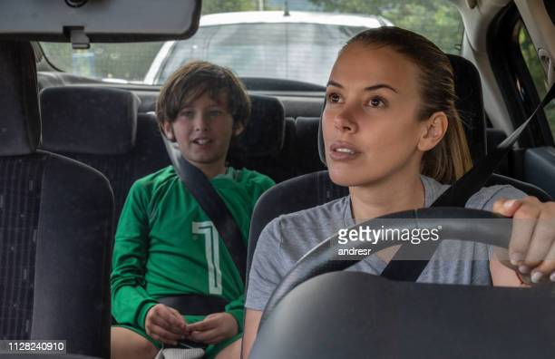
Diane Montgomery
Needs
Scenario
Kids selection of cleats and jerseys
Online selection option for kids
Cleat options for all shoe sizes
Clear price tag
Cleat use options
After looking online for soccer stores she finds that many of the stores do not have kids soccer equipment. Frustrated, she decides to see if a local soccer shop she’s seen, Top Bins has an online selection that can help her.
Narrative
Diane Montgomery is a 28 year old mother of 2 children in Leiper's Fork, TN. She is a nurse and works the night shift. In the day she likes to take care of her children and help her husband around the house. She just recently signed one of her children up for soccer. Her son grew from last year and needs a new jersey and cleats
Result
Diane decides to search for cleats and is ecstatic find a extensive selection of children’s cleats. In addition, she finds jerseys in kids and adult sizes so she can find the size and jersey that her child needs. She finds it relieving that the website has an easy navigation system and it allows her to look at all of the possible options for her son. She proceeds to put the cleats and jersey in her cart and is delighted when they both arrive.

Slide 23
User Stories Table
User | User Story
Persona 1: Diane Montgomery | As a user I need a kids selection of cleats and jerseys
Persona 1: Diane Montgomery | As a user I need an online section in the website specifically for kids gear
Persona 1: Diane Montgomery | As a user I need clear price tag on the items
Persona 1: Diane Montgomery | As a user I need cleat usages explanation

Slide 24
Website taxonomy
Chapter 3

Slide 25
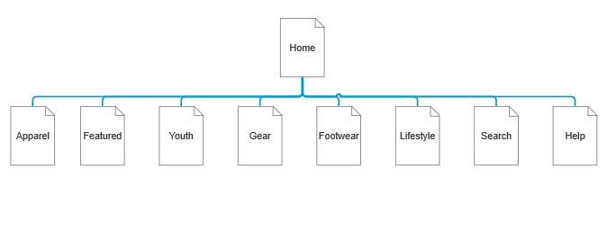
Website Taxonomy: Main Sections

Slide 26
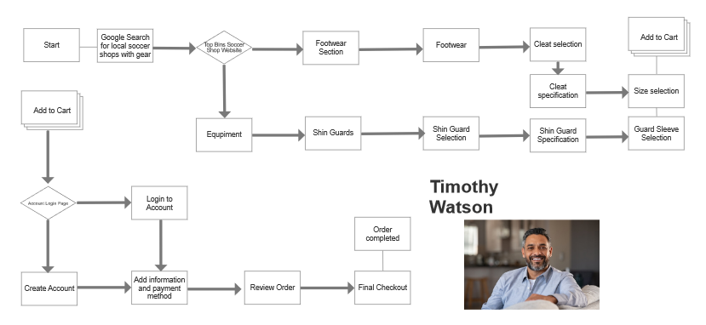
User Persona Flow 1

Slide 27
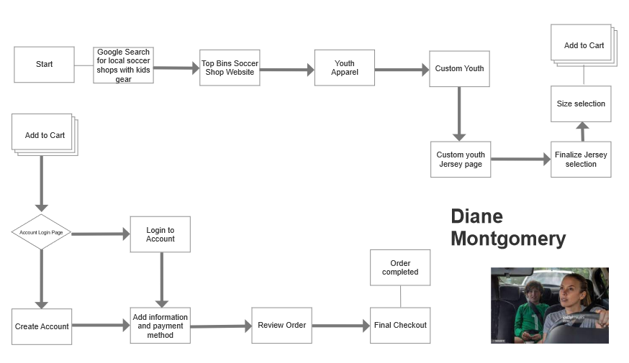
User Persona Flow 2

Slide 28
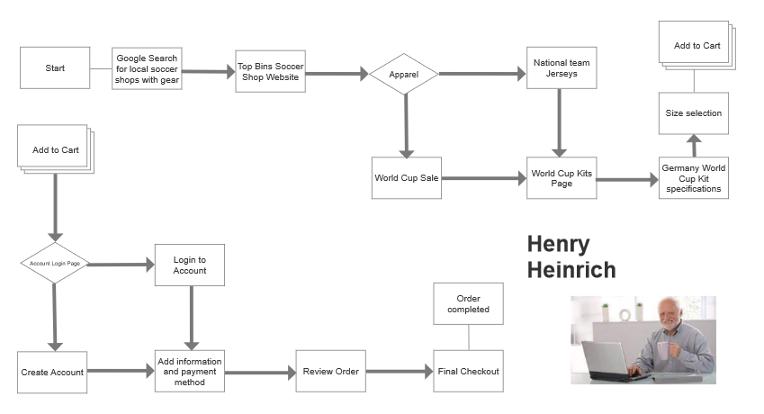
User Persona Flow 3

Slide 29
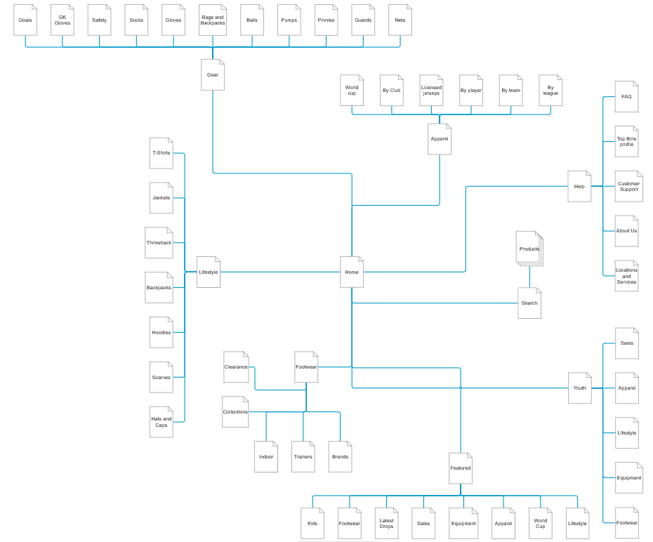
Complete Site Map

Slide 30
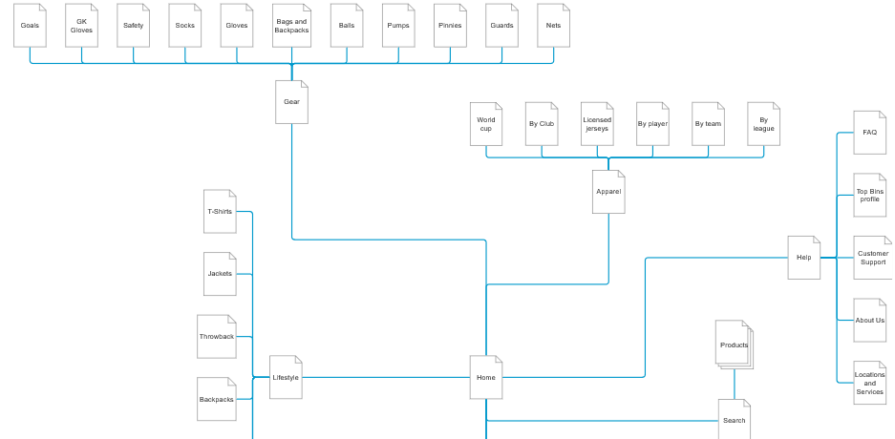
Site Map Split 1

Slide 31
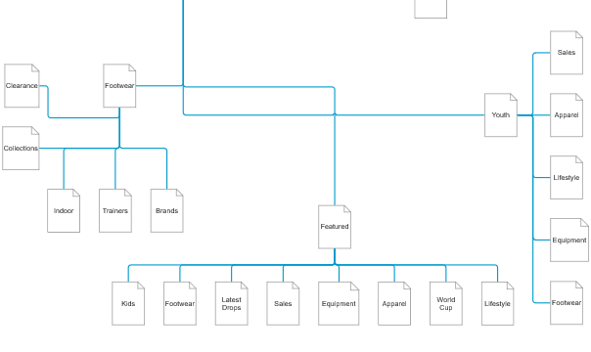
Site Map Split 2

Slide 32
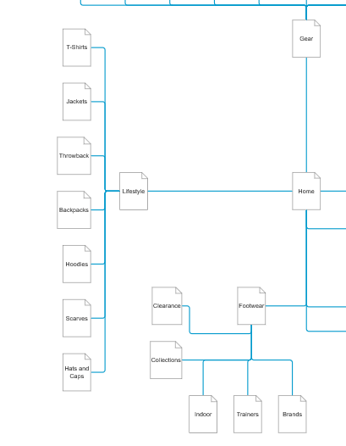
Site Map Split 3

Slide 33
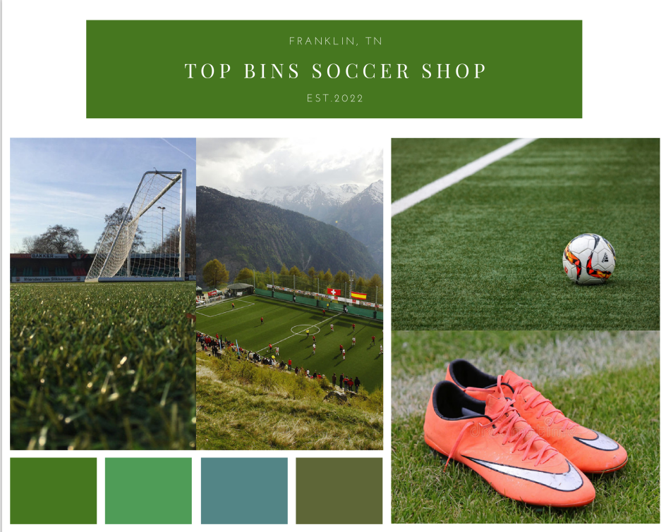
Summary and Synthesis
The taxonomy of the website is designed to allow the user to efficiently navigate to the products. Because users usually have a specific product in mind, the main sections categorize the products by the items themselves so the users can find what they want quickly.
The sections then split items to categories of the equipment, brand, specification, collection, and by player so the user can browse through different webpages with options and breadcrumbs to make navigation effortless.

Slide 34
Website Wireframes
Chapter 4

Slide 35
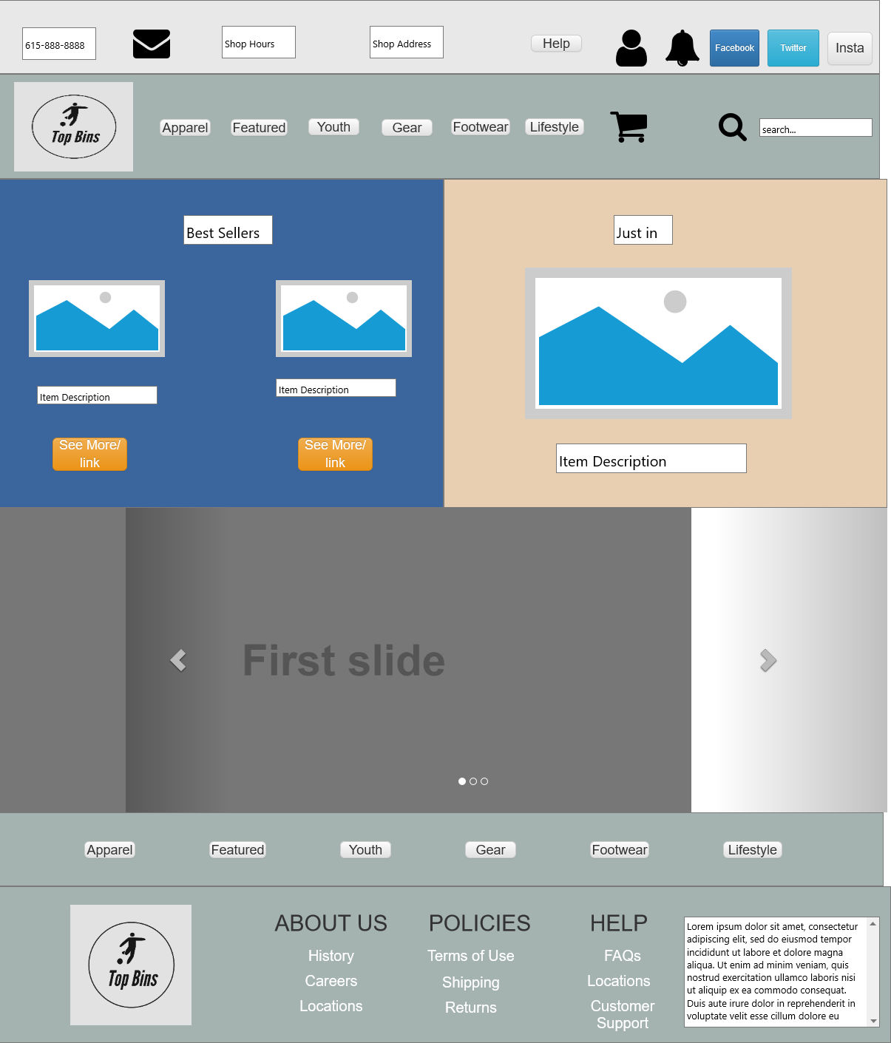
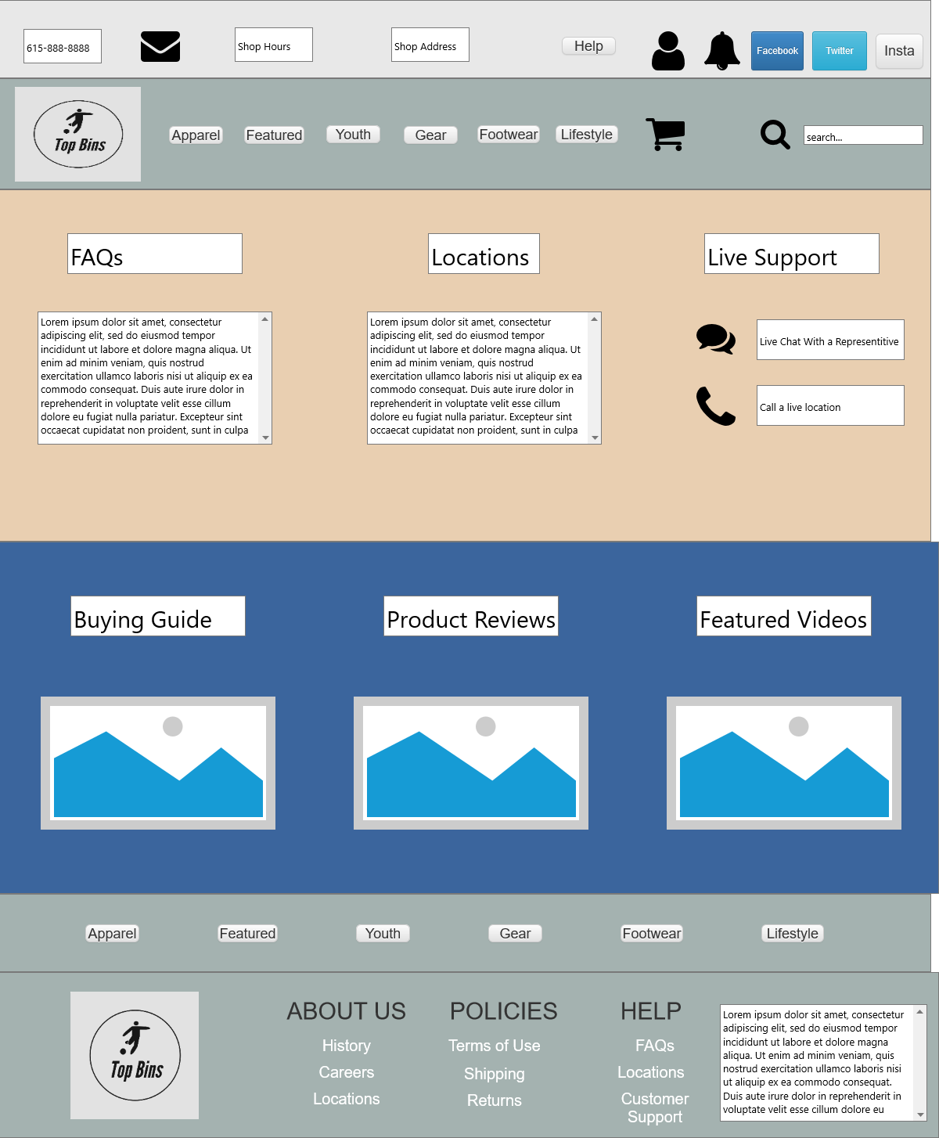
Wireframe Scope and Detail
Home Page
Help Page

Slide 36
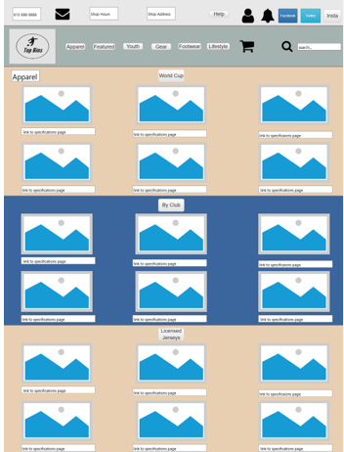
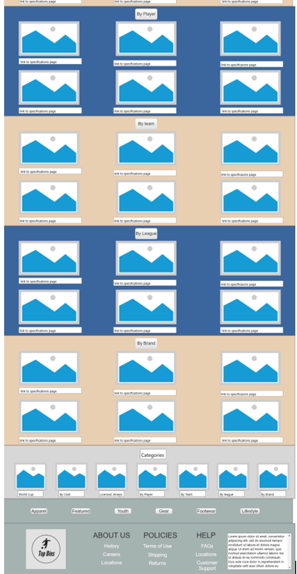
Wireframe Scope and Detail
Apparel page

Slide 37
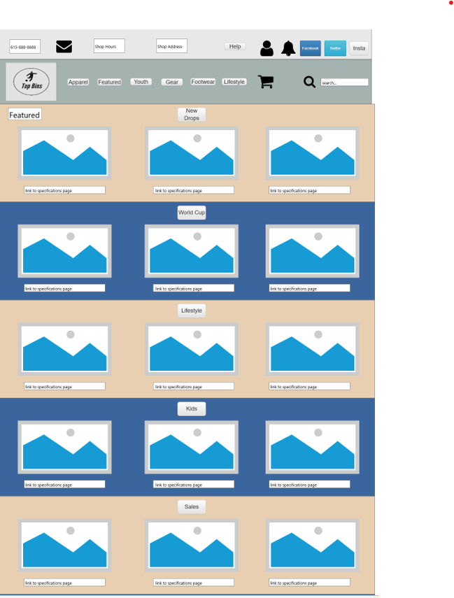
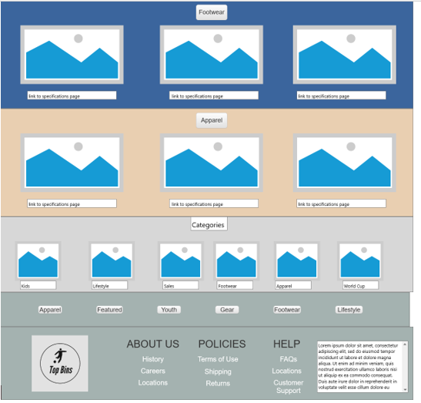
Wireframe Scope and Detail
Featured page

Slide 38
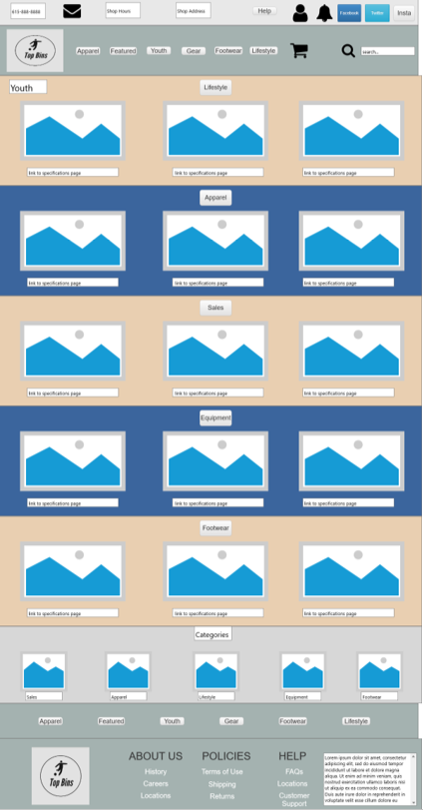
Wireframe Scope and Detail
Youth page

Slide 39
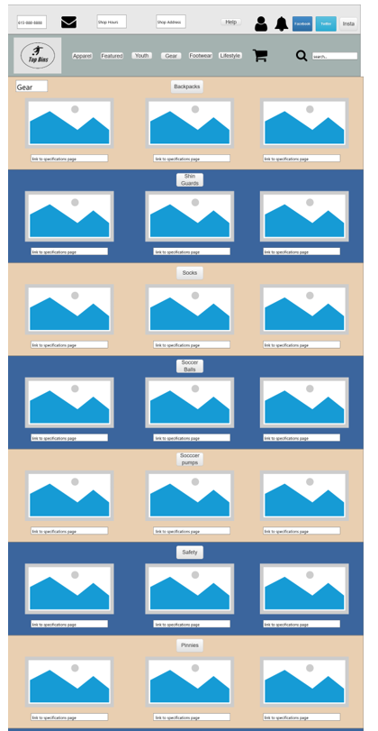
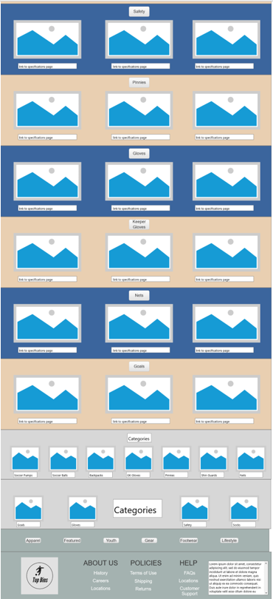
Wireframe Scope and Detail
Gear page

Slide 40
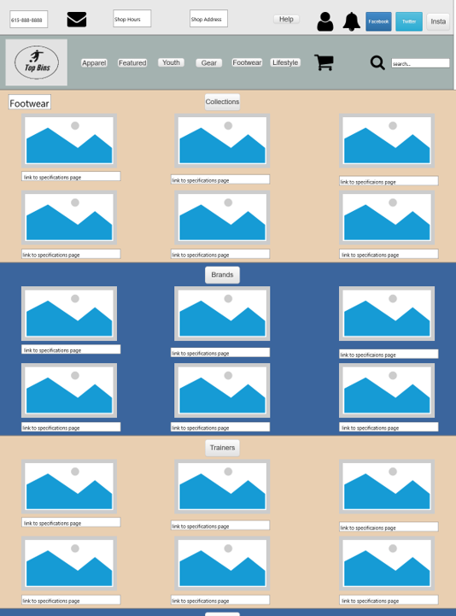
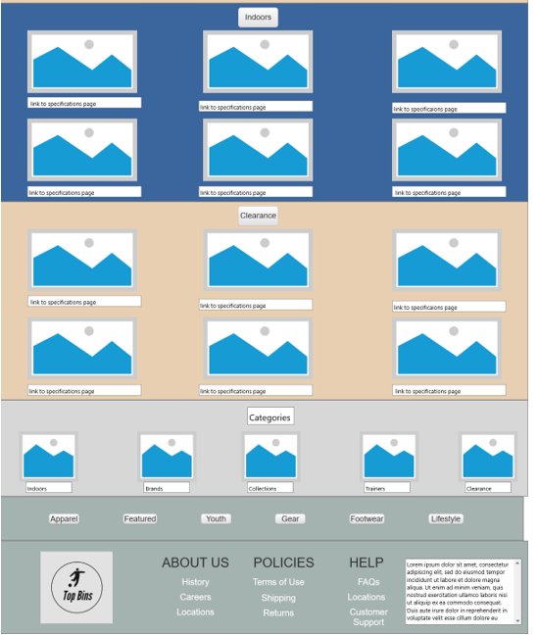
Wireframe Scope and Detail
Footwear page

Slide 41
Wireframe Scope and Detail
Lifestyle page

Slide 42
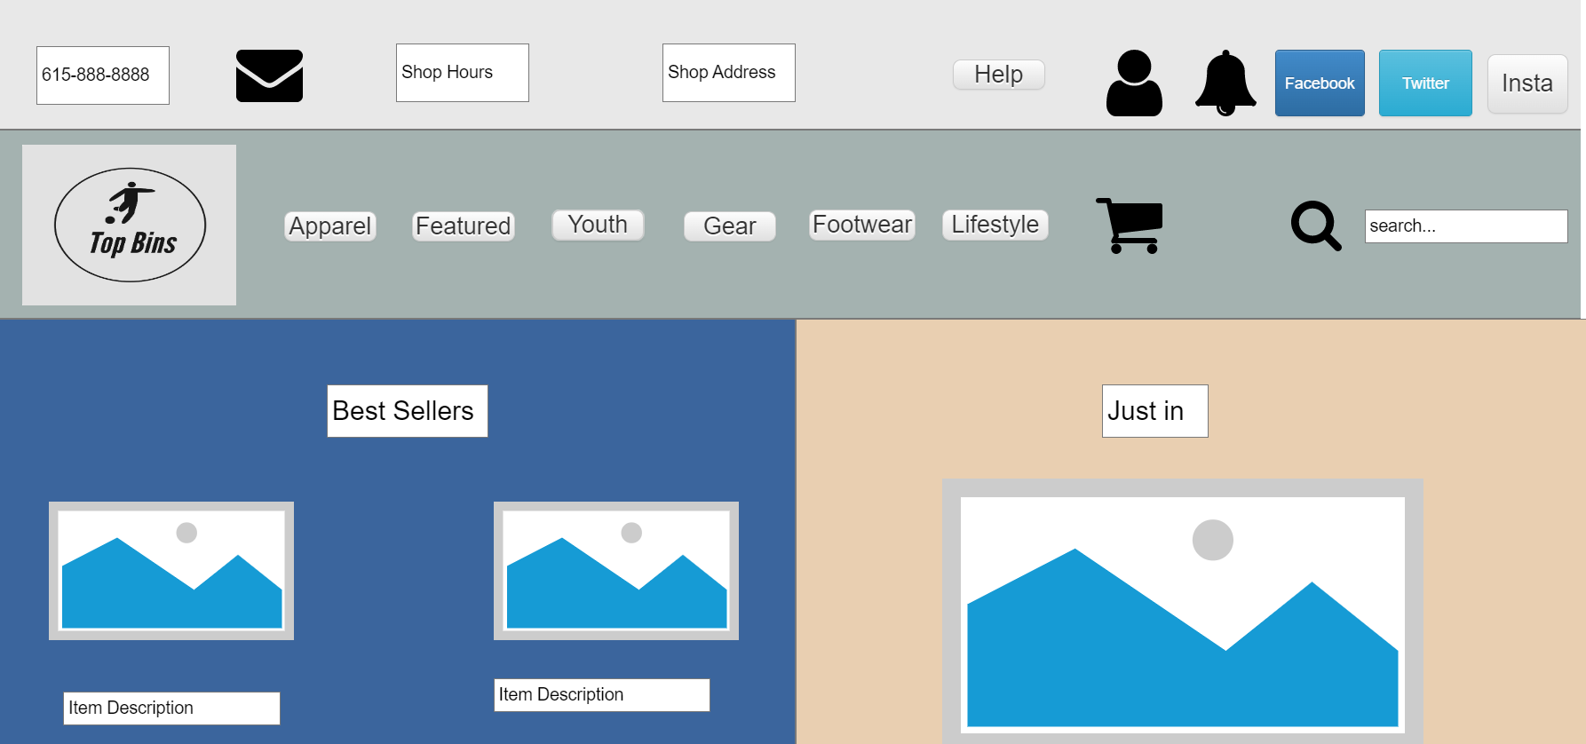
Hierarchy of Visual Precedence
Home Page
As the user initially navigates to the home page, the middle section of the header, which is the location of the Top Bins logo and site navigation is the first noticed and is the location at eye level. It contains the most important elements of the home page and is made to be noticed first. Second is the site content which contains large images and labels. Last is the top of the footer with helpful connection elements.

Slide 43
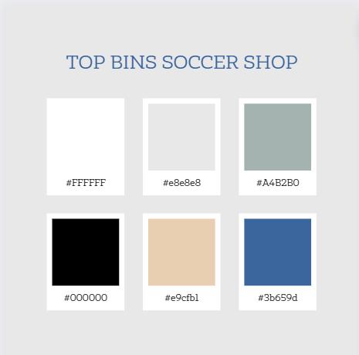
Color Palette Balance and Unity
Headings – Georgia Bold
Abcdefghijklmnopqrstuvwxyz
0123456789
Body – Georgia
Abcdefghijklmnopqrstuvwxyz
0123456789
The dominant color of blue combined with the secondary gold are the main colors of the Top Bins Website

Slide 44
Responsiveness of Design - Base
Featured – Normal Window

Slide 45
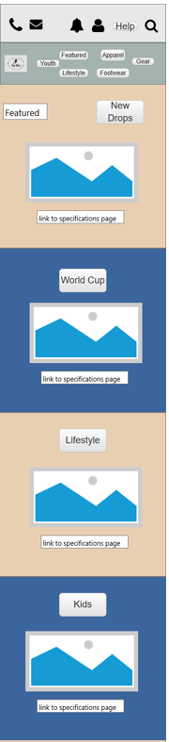
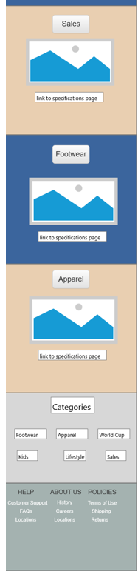
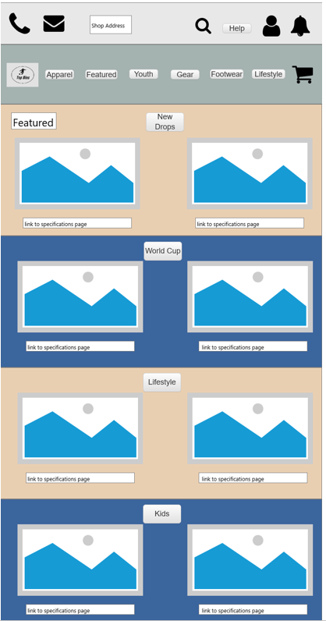
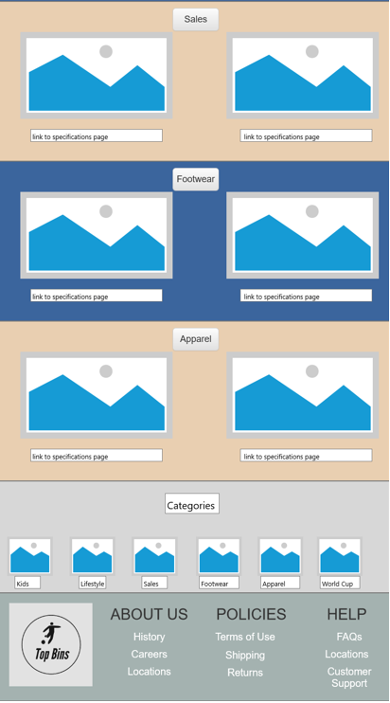
Responsiveness of Design
Featured – Mobile View
Featured – Tablet View

Slide 46
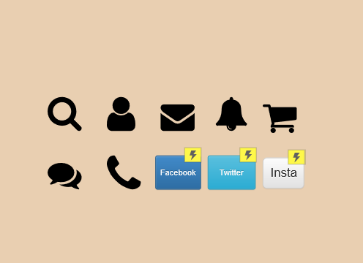
Implementation of Icons
The implementation of icons mostly applies to the navigational elements of the Top Bins Soccer Shop Website. Because much of the ecommerce section is image and description based, most icon elements are located in site header and footer. These icons represent elements of the webpage that helps the user navigate or consume content.

Slide 47

Summary
The ecommerce aspect of the website makes many of the initial sales pages look similar. The navigational elements combined with the content based product pages allows the customer to find what they need in an efficient fashion. The intention of each page defines the product layout that is used. The navigational breadcrumbs are vital to the product selection process and visual precedence of the site header allows for the user to view different products with ease.

Slide 48
User Testing and Revisions
Chapter 5

Slide 49
User Survey Questions –Demographic
When asking the participant about demographic information, my goal was to categorize them by age, gender, internet experience level, and asking how often they shop online.
Questions
Age?
Gender?
What is your internet experience level?
Do you have any prior online shopping experience?
What device do you primarily access the internet from?

Slide 50
User Survey Questions - Qualitative
When asking the participant qualitative questions, I sought to gain insight on their opinions about certain aspects of the site, their ideas for improvement, and their likeliness to visit the website.
Questions
Best aspect of the website?
Was each major section labelled correctly?
What improvements do you have for the site?
Did any part of the site give you any frustrations?
Would you consider using this site again?

Slide 51
User Survey Questions - Quantitative
The quantitative section of the questions aimed to gauge the user’s ratings of the webpages and the effectiveness of the site’s navigation.
Questions
Home page Satisfaction?(1-5)
Ease of Navigation?(1-5)
Webpage Structure?(1-5)
Overall rating of the website?(1-10)

Slide 52
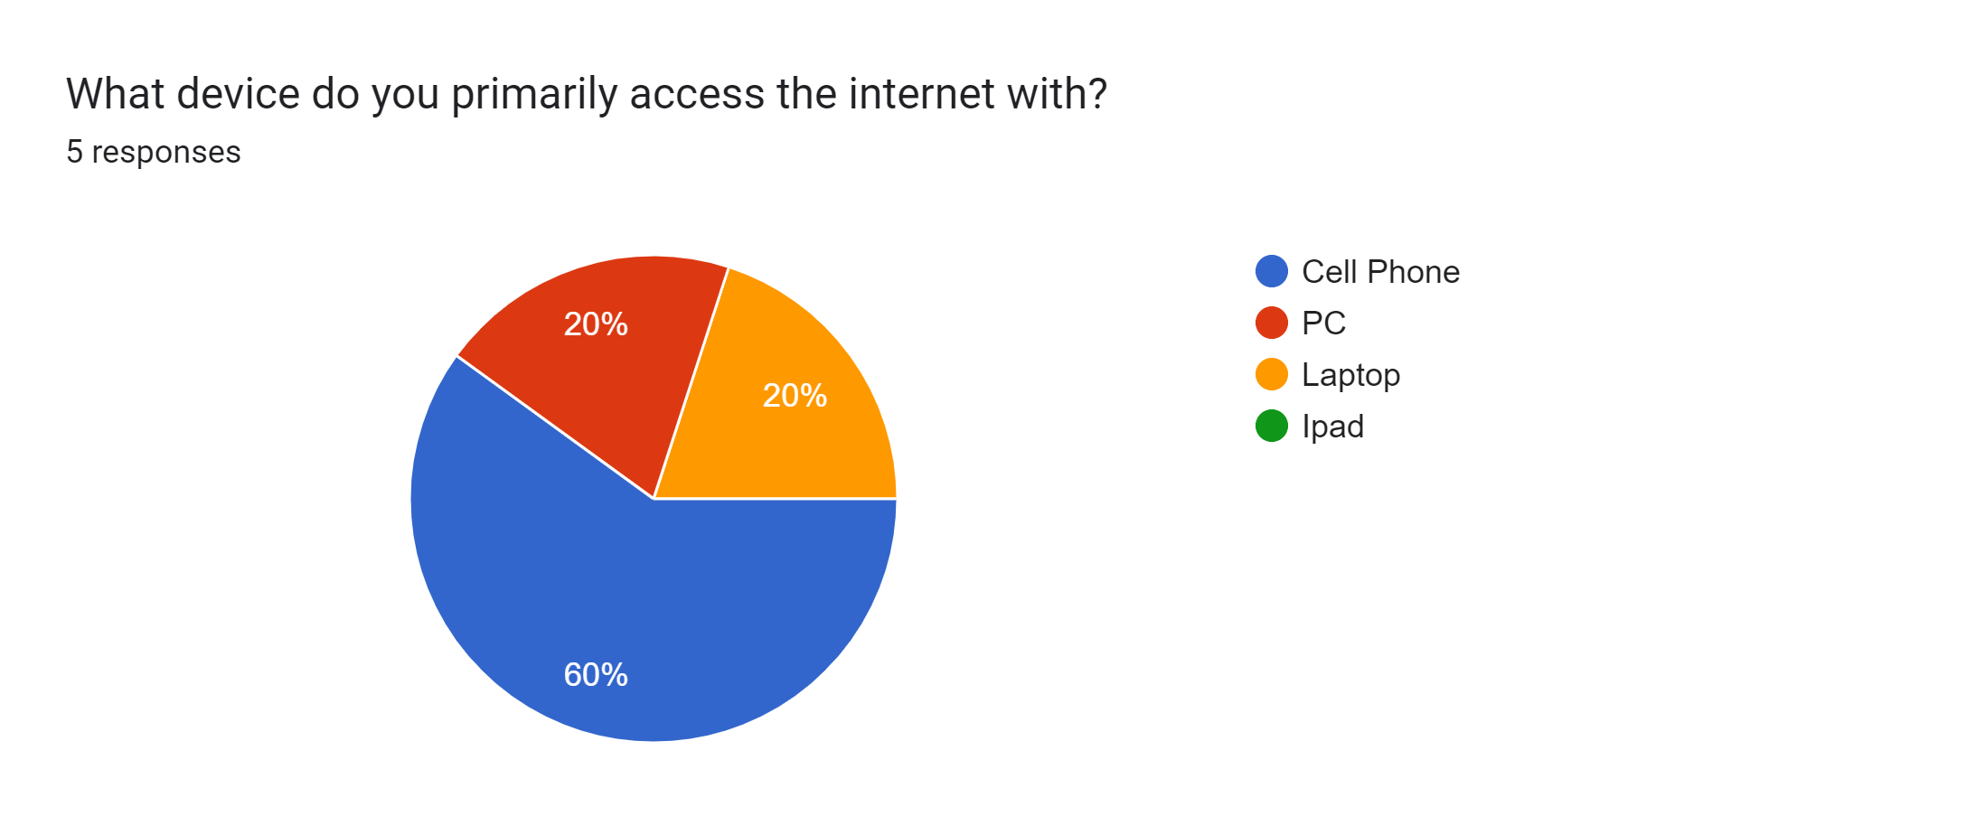
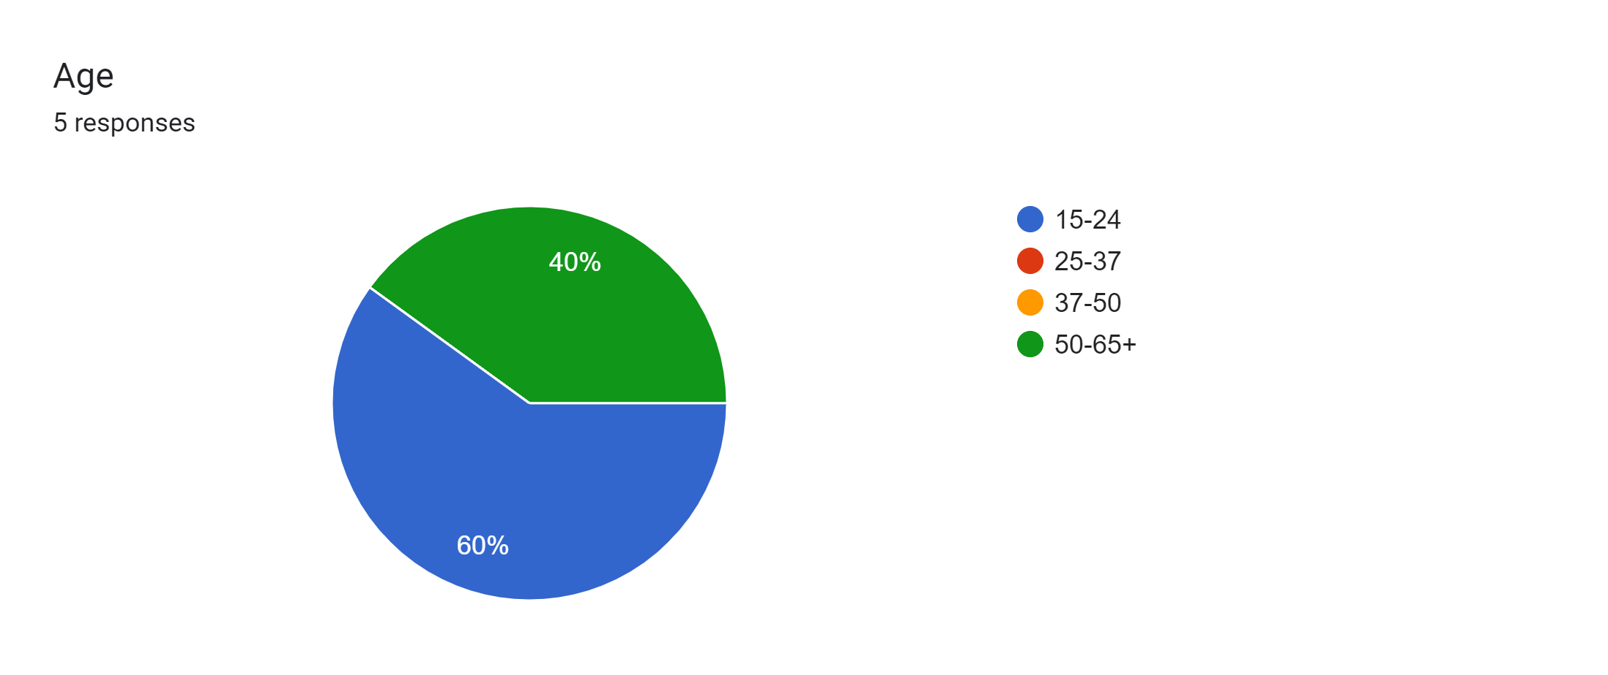
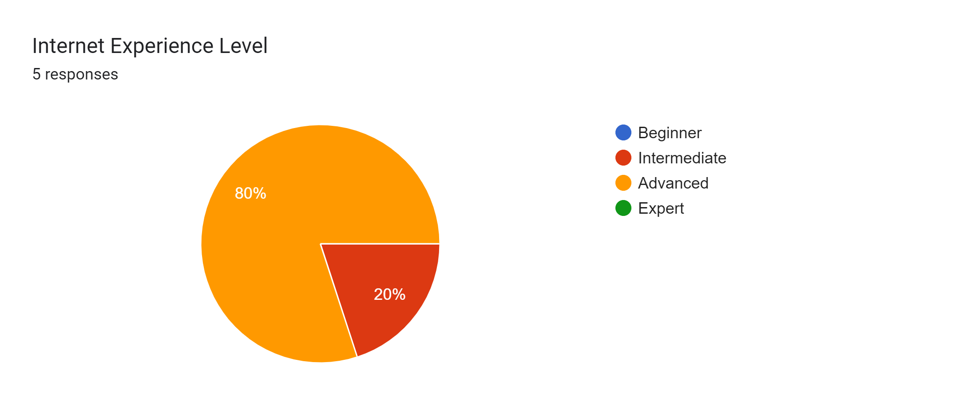
User Testability Process
Based on the demographic information of each user, I matched each of them with the closest corresponding persona. I gave each user a number of tasks to do based on their profile and recorded their time it took to complete the tasks. After, each user was asked a series of questions and their responses, feedback, and suggestions were recorded.

Slide 53
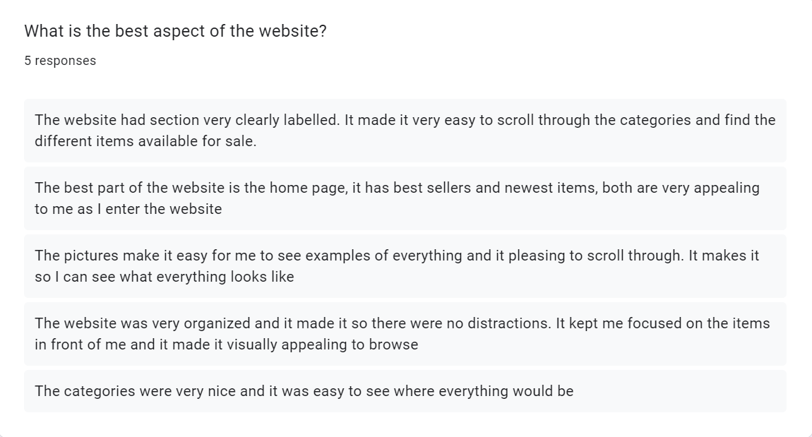
Qualitative Analysis and Results
Many of the compliments of the website pertained to the organization of the website and the clearly defined categories. The product images and global navigation were the vital in establishing this and made the customer’s experience easy.

Slide 54
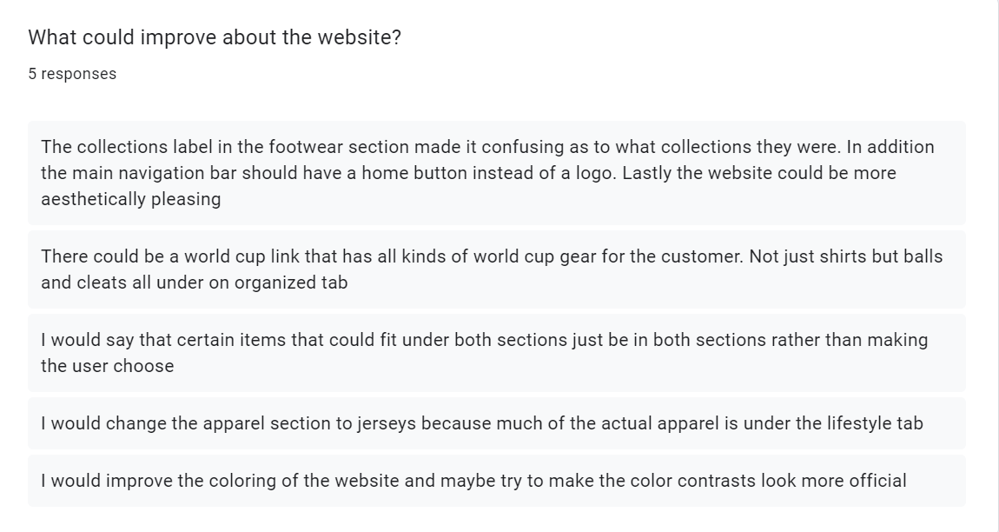
Qualitative Analysis and Results
For this question, much of the confusion that the users experienced pertained to the categorization of certain products. The ambiguity of a few of the category labels and even a few product sections gave customers trouble when searching for certain items.

Slide 55
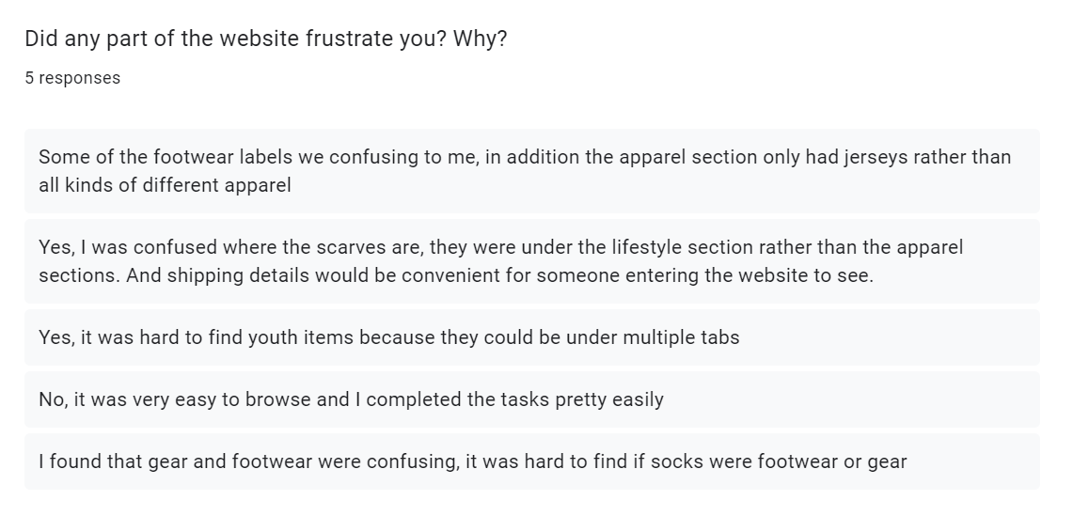
Qualitative Analysis and Results
Much of the user frustration came from the labels in the global navigation bar and how certain products fit under each section. A few products, such as socks, could be under multiple sections but were only under the gear section. A revision to move them under all three sections would fix this issue.

Slide 56
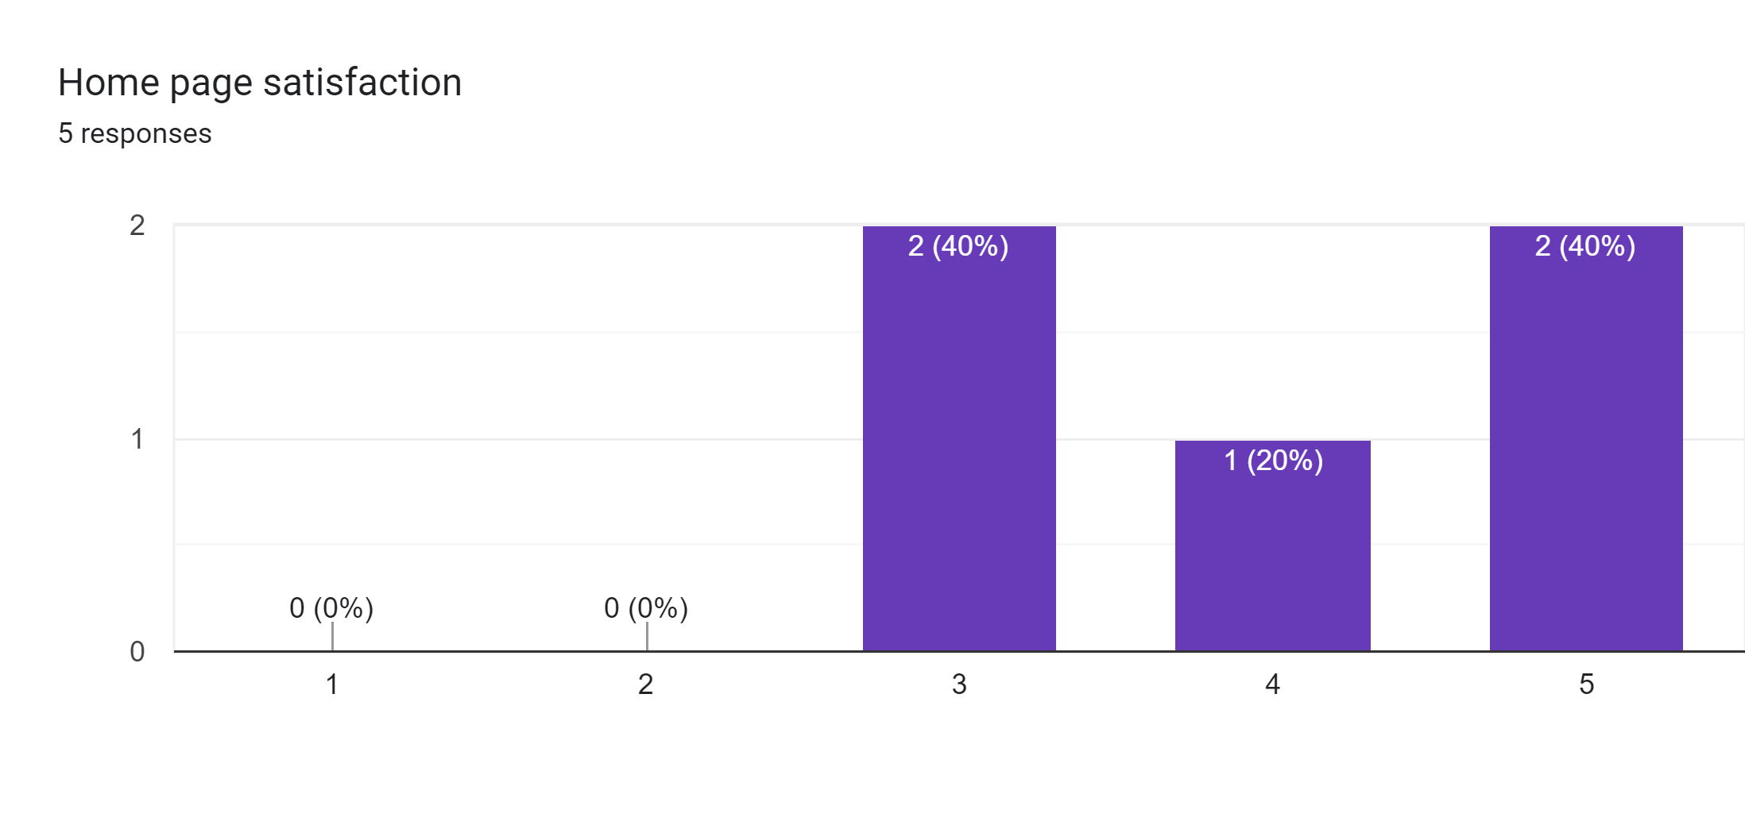
Quantitative Analysis Results(Bad 1 – 5 Good)
Most of the users were satisfied with the homepage. The global navigation allowed for the users to find the content that they wanted quickly. It is vital that the home page can also have enough content to help guide the user’s interests. I think that the current home page structure allowed for it to serve as a navigation springboard and a consumption to help guide the user’s interests.

Slide 57
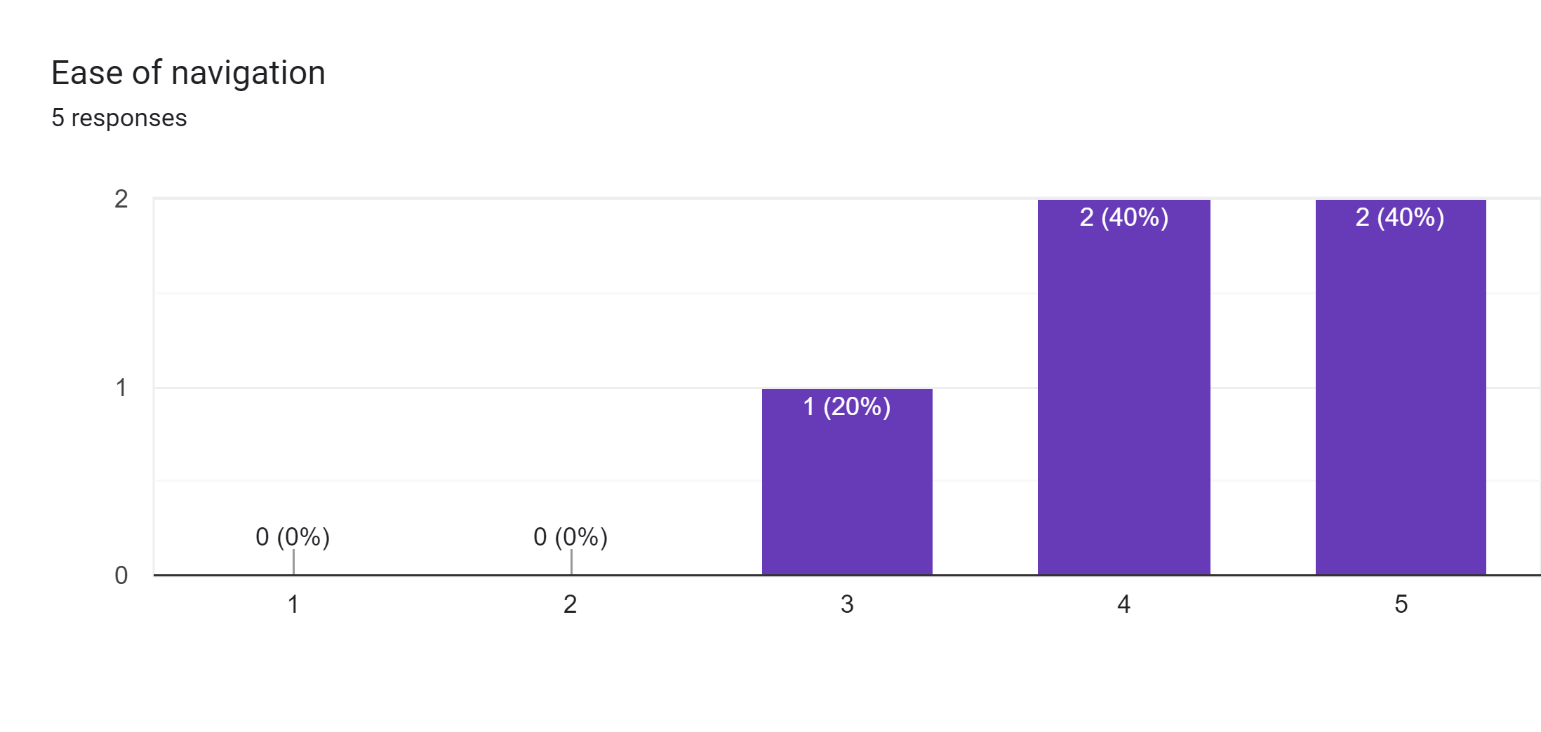
Quantitative Analysis Results(Bad 1 – 5 Good)
The global navigation bar located at the top and bottom of every webpage was something the user responded very well to. It helped them have an idea of where they can access and what they can look for. It did provide some confusion though as it was complicated for the user to navigate back to the home page.

Slide 58
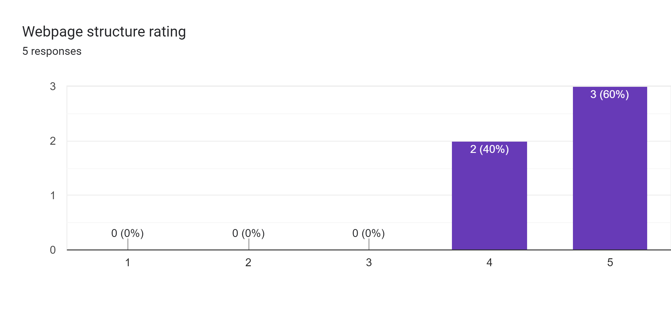
Quantitative Analysis Results(Bad 1 – 5 Good)
The users rated the webpage structure highly. Because the pictures were next to the item labels, it made the customer more likely to stay on the site and continue scrolling on the different item webpages. This also got many praises from the customers and made the webpage structure rating high

Slide 59
Final Synthesis
After giving the prototype to prospective users and using persona based tasks to test, I found that main strengths of the website are the main navigation bar, the clearly defined product sections, and the visual feedback that each webpage provides with the pictures and labels of each product.
This helped the users easily find what they needed in an efficient and timely fashion. It made the website realistic.
The weaknesses of the prototype includes the locations of certain products. A few specific items could be under multiple sections so the user struggled to find and differentiate which items are under which sections.
A few improvements could be made to the main navigation bar because of the vagueness of a few labels, In addition a few products could be added to other locations based what categories they could fit under.

Slide 60
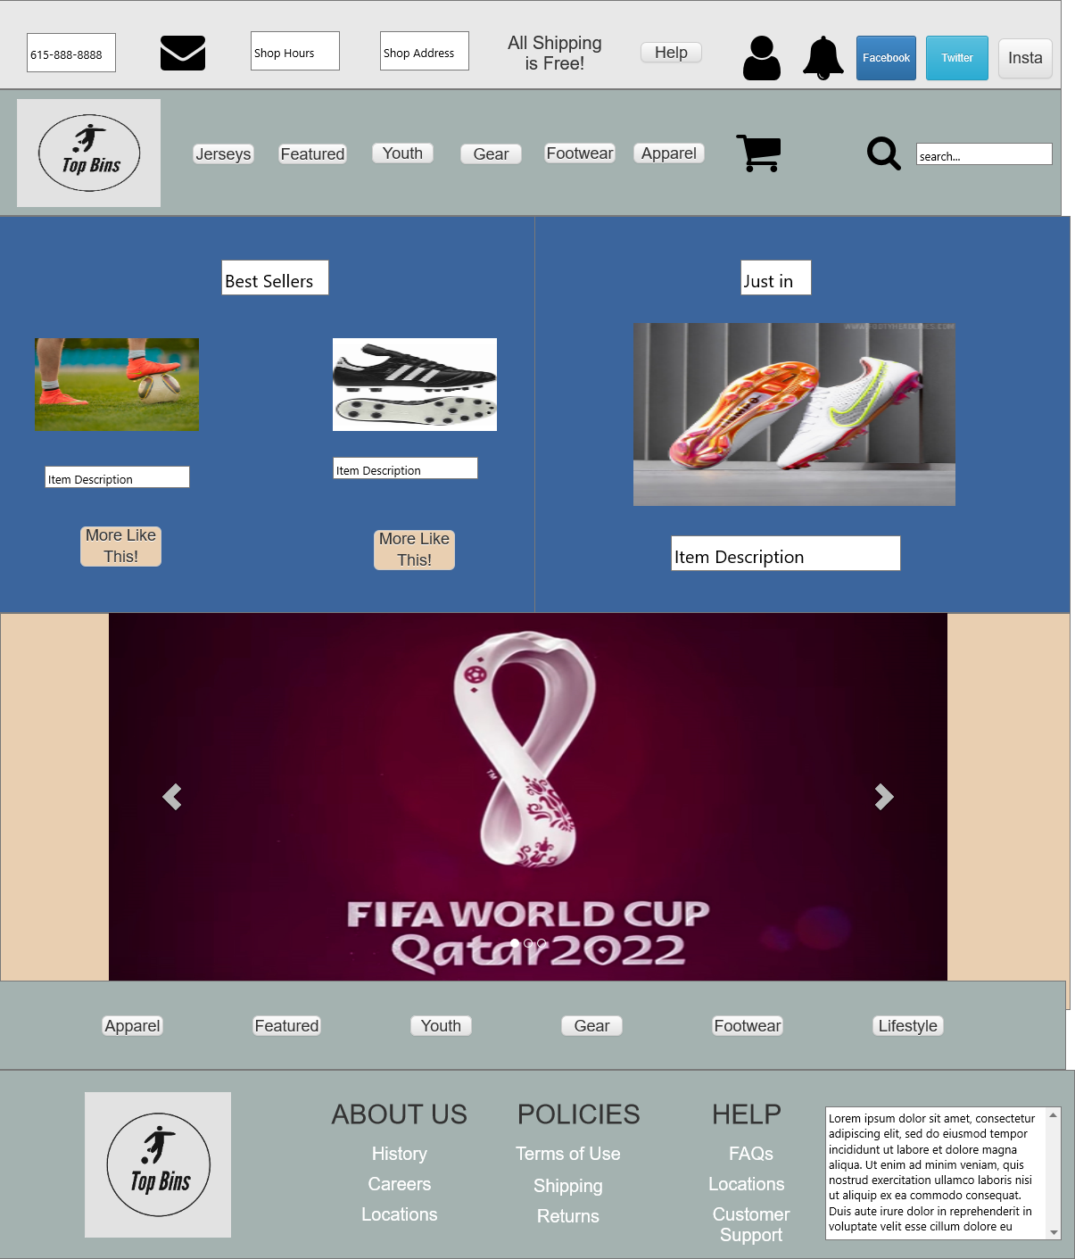
Wireframe Changes
The first of the changes was applied to the Home page. The navigation bar has had the section Apparel edited. It has been changed to say jerseys because much of the apparel section had jerseys and the label was ambiguous to the user.

Slide 61
Wireframe Changes
The second change was applied to the home page as well. The lifestyle section located at the very right of the navigation bar has been changed to apparel. Because it contains more common clothes and casual clothing, the label was more appropriate and takes the vagueness out of that section.

Slide 62
Wireframe Changes
In addition to the previous sections, a world cup tab has been added to the home page. This makes it possible for the user to see world cup related content. Because it isn’t prominent enough section to be added to the navigation bar, a visual on the first page can draw the user to current events and lead them to world cup related content

Slide 63
Wireframe Changes
Lastly, the label all shipping is free was added to the secondary navigation bar. This makes the user aware of the shipping cost and allows them to make purchases with this helpful information in mind.

Slide 64
Components of Visual Design
Chapter 6

Slide 65
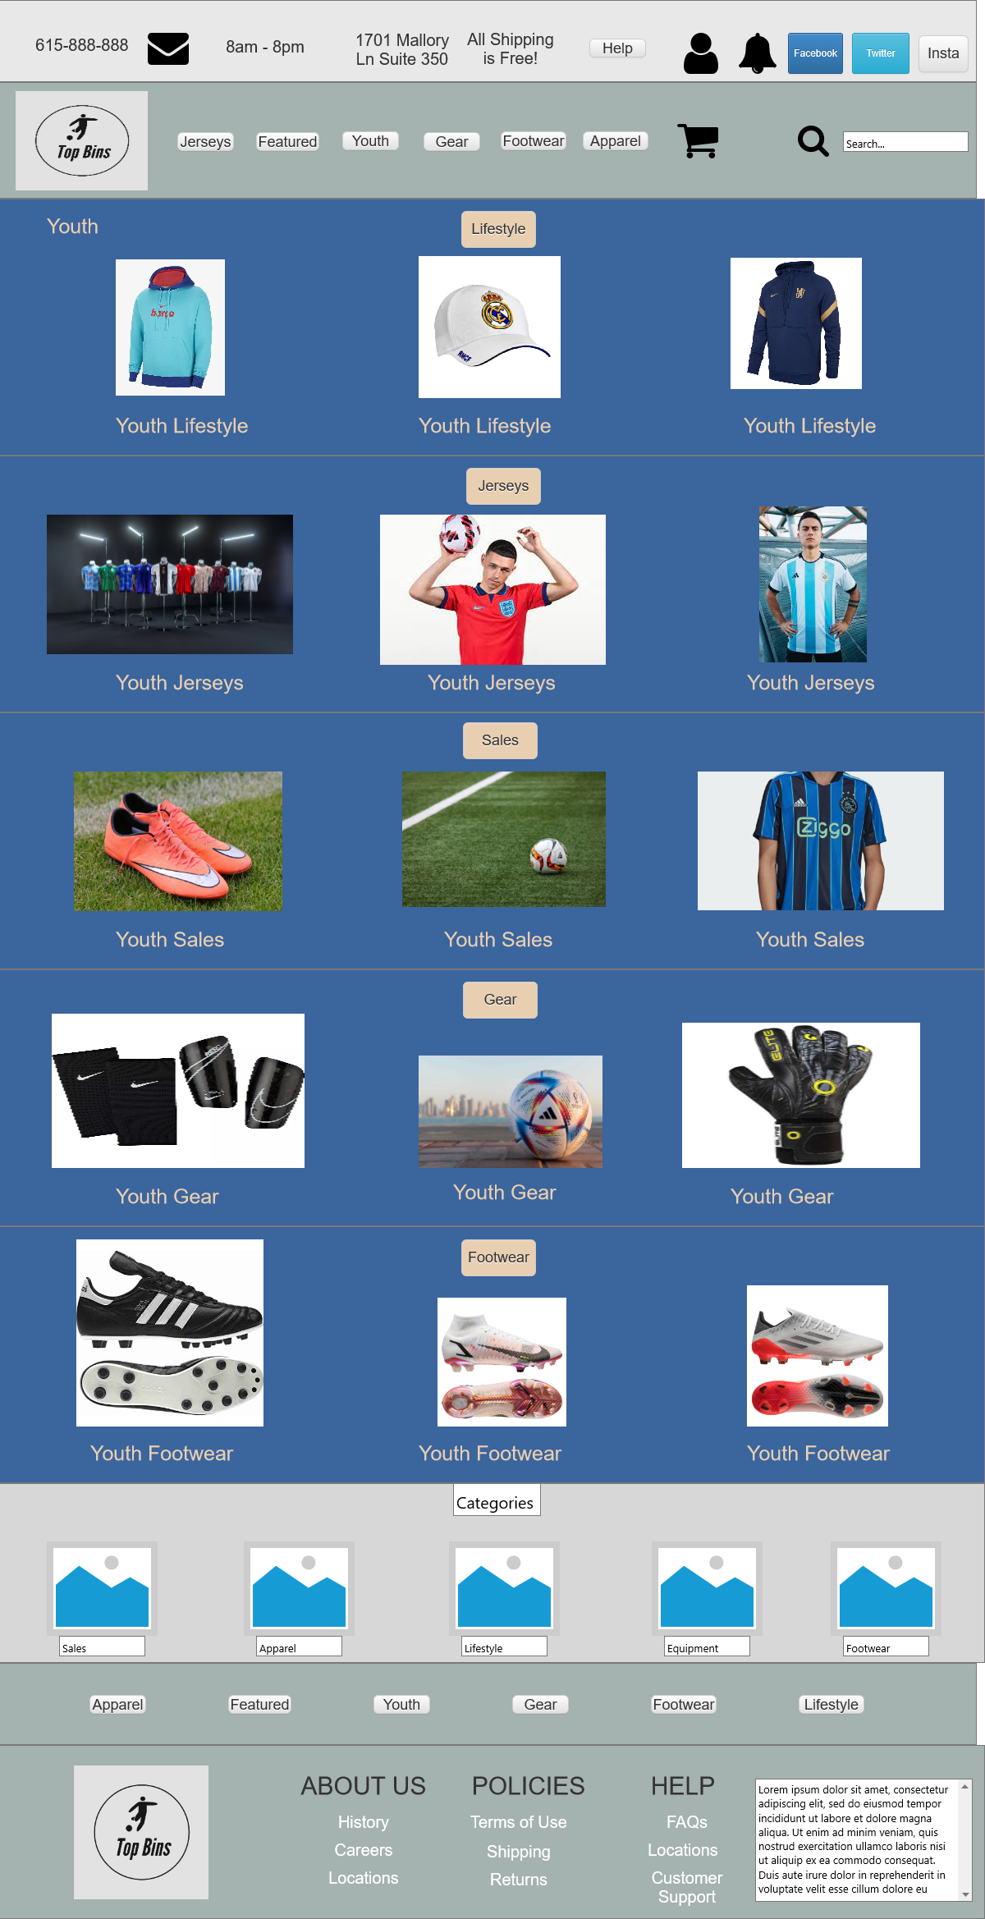
Updated Color Palette Balance and Unity
The original iteration of the website had a background combination of gold and blue. I unified the background with the navy blue and used the gold as a contrasting color. The navigation bar colors contribute well to the visual hierarchy so they remained the same. The universal font of Georgia is versatile and web-safe for the Top Bins website and is used site-wide.
Headings – Georgia Bold
Abcdefghijklmnopqrstuvwxyz
0123456789
Body – Georgia
Abcdefghijklmnopqrstuvwxyz
0123456789

Slide 66
Implementation of Icons
The Icons used remained unchanged throughout the design process because of the consistency of the global navigation bar. Many of the icons are helpful in the navigation of the website and are vital to the navigation of the website and the access of information. Additional personalized buttons were added as labels to each individual section of the website for specification pages of each product

Slide 67


Top Bins Website Mockups

Slide 68


Top Bins Website Mockups

Slide 69
Summary and Synthesis
The design of the Top Bins Soccer Shop Website is made to maximize user experience in the process of online shopping for high quality gear. Each page is made to display the gear in an organized fashion. The colors of the store are integrated into each webpage and the pictures of each product allows visual reinforcement for the user to help maximize the buying process. Each page allows the user to know where they are and where they can go. I found that the website design of a navigation centered home page and content consumption based shopping pages was most efficient in allowing customers to find and research the available products. It also made the website adaptable to multiple devices and simple to navigate.

